Slide 1
Arrhythmias
Dr Wainaina Samuel

Slide 2
Arrhythmias
Arrhythmias and conduction disorders are caused by abnormalities in the generation or conduction of these electrical impulses or both.
Any heart disorder, including congenital abnormalities of structure or function, can disturb rhythm.
Systemic factors that can cause or contribute to a rhythm disturbance include electrolyte abnormalities, hypoxia, hormonal imbalances, and drugs and toxins.

Slide 3
Normal cardiac rhythm
The resting sinus heart rate in adults is usually 60 to 100 beats/min.
Sinus bradycardia occur in young people, particularly athletes, and during sleep.
Sinus tachycardia occur during exercise, illness, or periods of intense emotion through sympathetic neural and circulating catecholamine drive.
Normally, a marked diurnal variation in heart rate occurs, with lowest rates just before early morning awakening.
A slight increase in rate during inspiration with a decrease in rate during expiration (respiratory sinus arrhythmia) is also normal;

Slide 4
Pathophysiology
Rhythm disturbances result from abnormalities of impulse formation, impulse conduction, or both.
Bradyarrhythmias result from decreased intrinsic pacemaker function or blocks in conduction, principally within the AV node or the His-Purkinje system.
Tachyarrhythmias are caused by reentry.
Reentry is the circular propagation of an impulse around 2 interconnected pathways with different conduction characteristics and refractory periods

Slide 5
Electrocardiogram(ECG)
Most cardiac electrical activity is represented on the ECG although SA node, AV node, and His-Purkinje depolarization does not involve enough tissue to be detected.
The P wave represents atrial depolarization. The QRS complex represents ventricular depolarization, and the T wave represents ventricular repolarization.

Slide 6
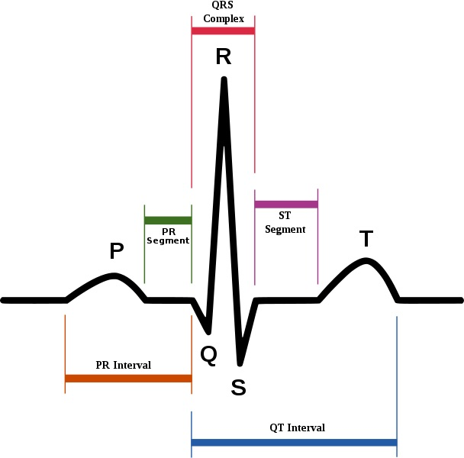
QRS COMPLEX

Slide 7
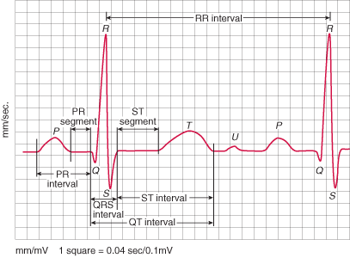
ECG Printout

Slide 8
Interpretation of the QRS Complex
The PR interval is the time from the beginning of atrial activation to the beginning of ventricular activation.
Much of this interval reflects slowing of impulse transmission in the AV node.
The R-R interval represents the ventricular rate.
The QT interval represents the duration of ventricular depolarization.
Normal values for the QT interval are slightly longer in women; they are also longer with a slower heart rate.

Slide 9
Symptoms and Signs
Palpitations (sensation of skipped beats or rapid or forceful beats),
Hemodynamic compromise (eg, dyspnea, chest discomfort, presyncope, syncope),
Cardiac arrest.
Polyuria results from release of atrial natriuretic peptide during prolonged supraventricular tachycardias (SVTs).

Slide 10
Diagnosis
The ECG is primary tool of diagnosis
The key diagnostic features are .
Rate of atrial activation
Rate and regularity of ventricular activation
The relationship between the two

Slide 11
Classification of Arrhythmias
Bradyarrhythmias
ECG diagnosis of bradyarrhythmias depends on the presence or absence of P waves, morphology of the P waves, and the relationship between P waves and QRS complexes
Tachyarrhythmias
Tachyarrhythmias are defined by the QRS complexes

Slide 12
Bradyarrhythmias
AV block is indicated by a bradyarrhythmia with no relationship between P waves and QRS complexes and more P waves than QRS complexes
Absence of AV block is indicated by a regular QRS bradyarrhythmia with a 1:1 relationship between P waves and QRS complexes.

Slide 13
Tachyarrhythmias
Atrial fibrillation (AF): Atrial ECG signals (usually best seen in lead V1) that are continuous, irregular in timing and morphology, and very rapid (> 300 beats/min) without discrete P wave
Atrial flutter: Regular, discrete, uniform atrial signals (usually best seen in leads II, III, and aVF) without intervening isoelectric periods, usually at rates > 250 beats/min

Slide 14
Treatment
The need for treatment of arrhythmias depends on the symptoms and the seriousness of the arrhythmia.
Treatment is directed at causes.
direct antiarrhythmic therapy, including
antiarrhythmic drugs,
cardioversion-defibrillation,
implantable cardioverter-defibrillators(ICDs),
pacemakers
catheter ablation
surgery

Slide 15
Disopyramide Procainamide* | APB and VPB suppression, SVT and VT suppression, AF or atrial flutter, and VF suppression
Quinidine* | Oral: 200–400 mg q 4–6 h
Lidocaine Mexiletine | Suppression of ventricular arrhythmias (VPB, VT, VF)

